Slide 1
G369 GA

Slide 2
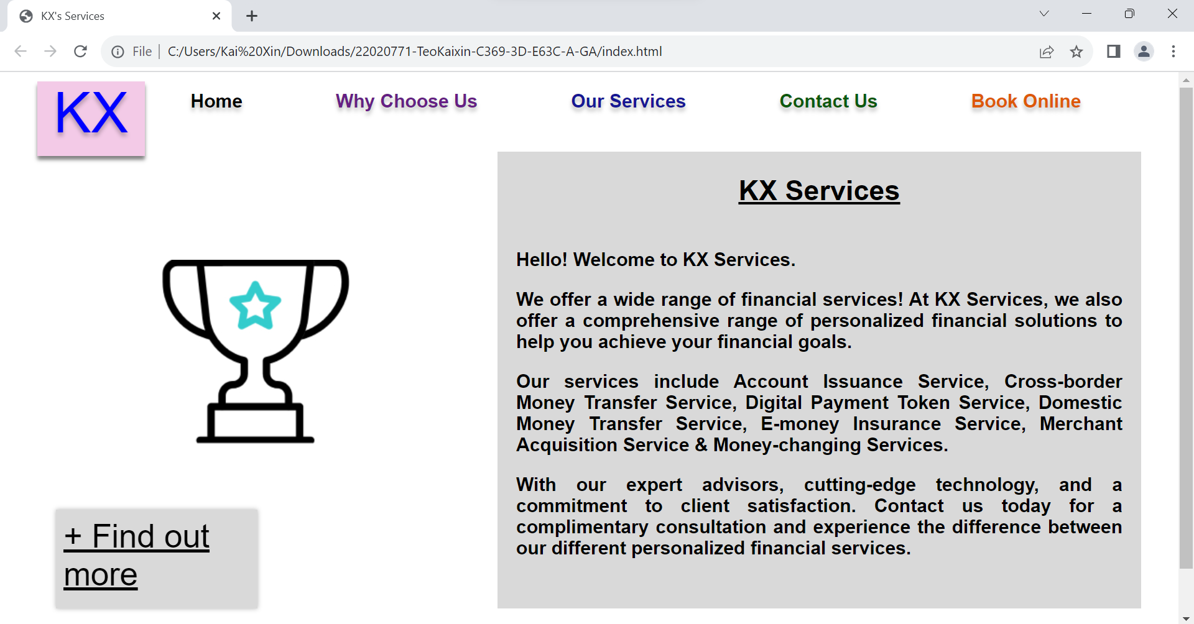
Home page

Slide 3
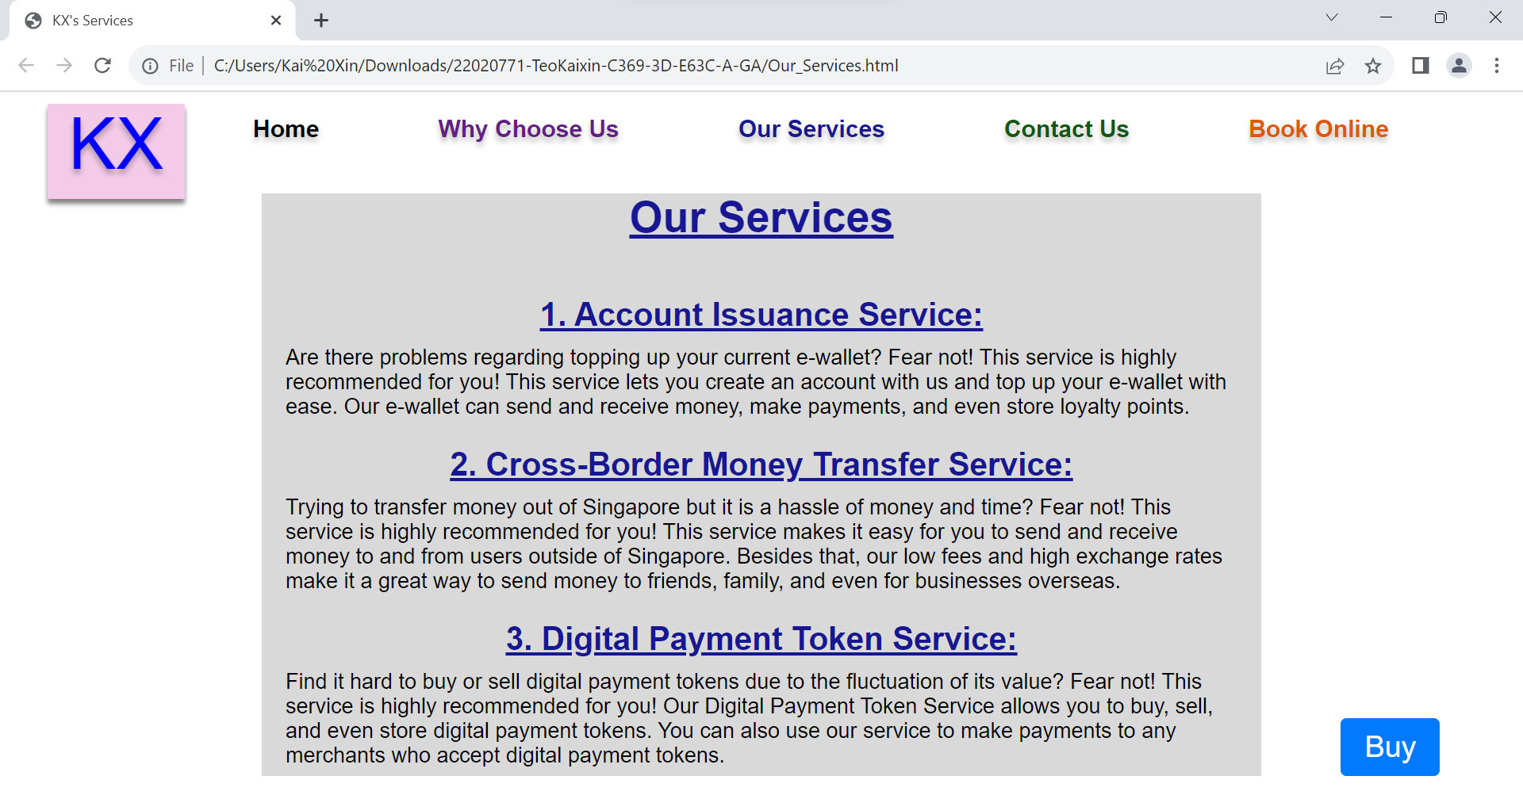
Our Services page

Slide 4
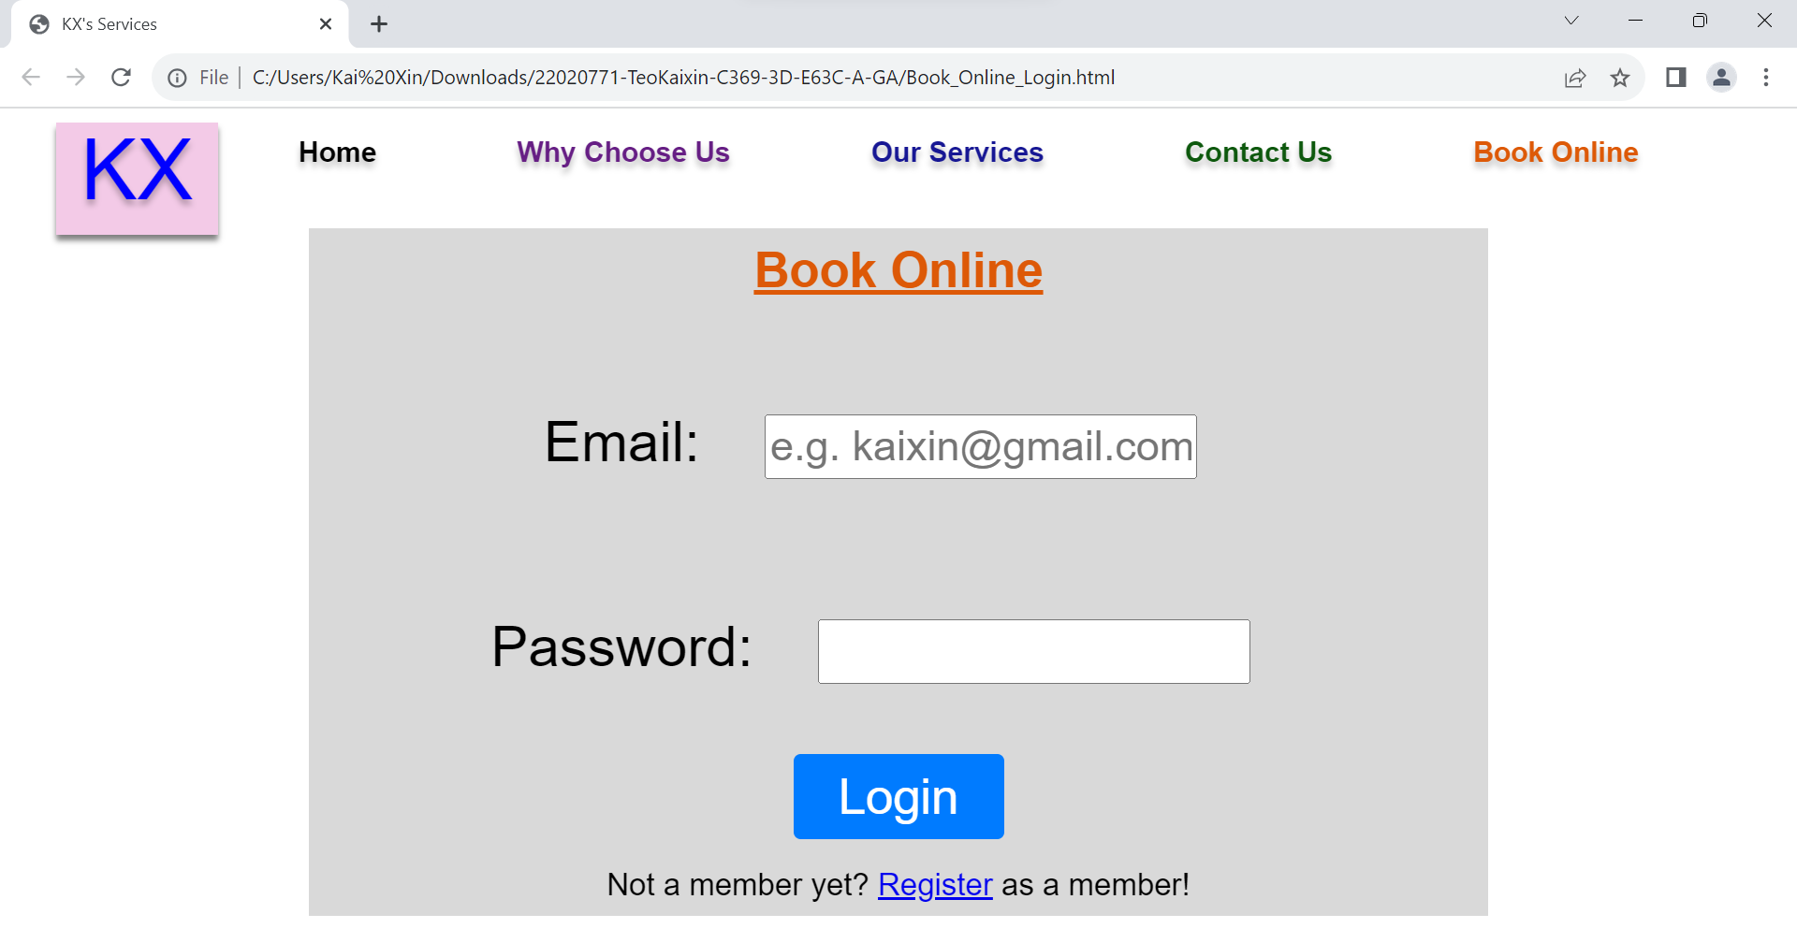
Login page

Slide 5
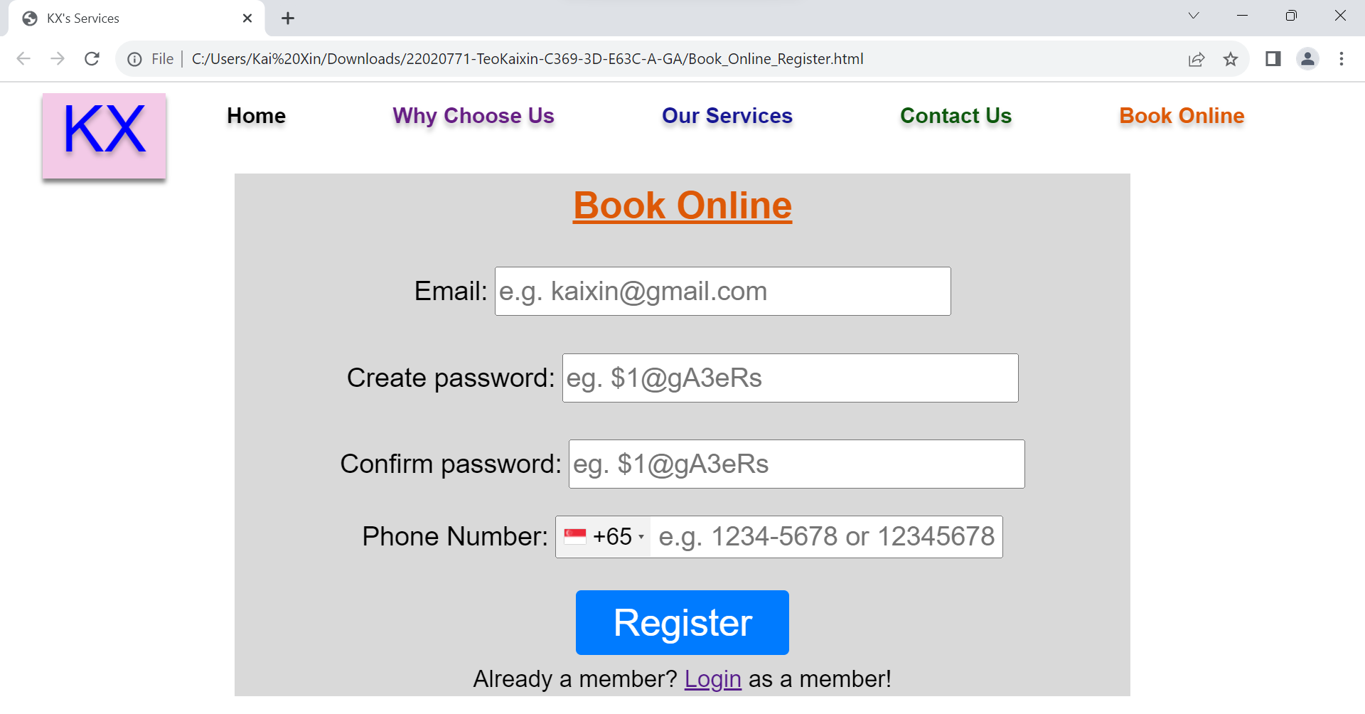
Register page

Slide 6
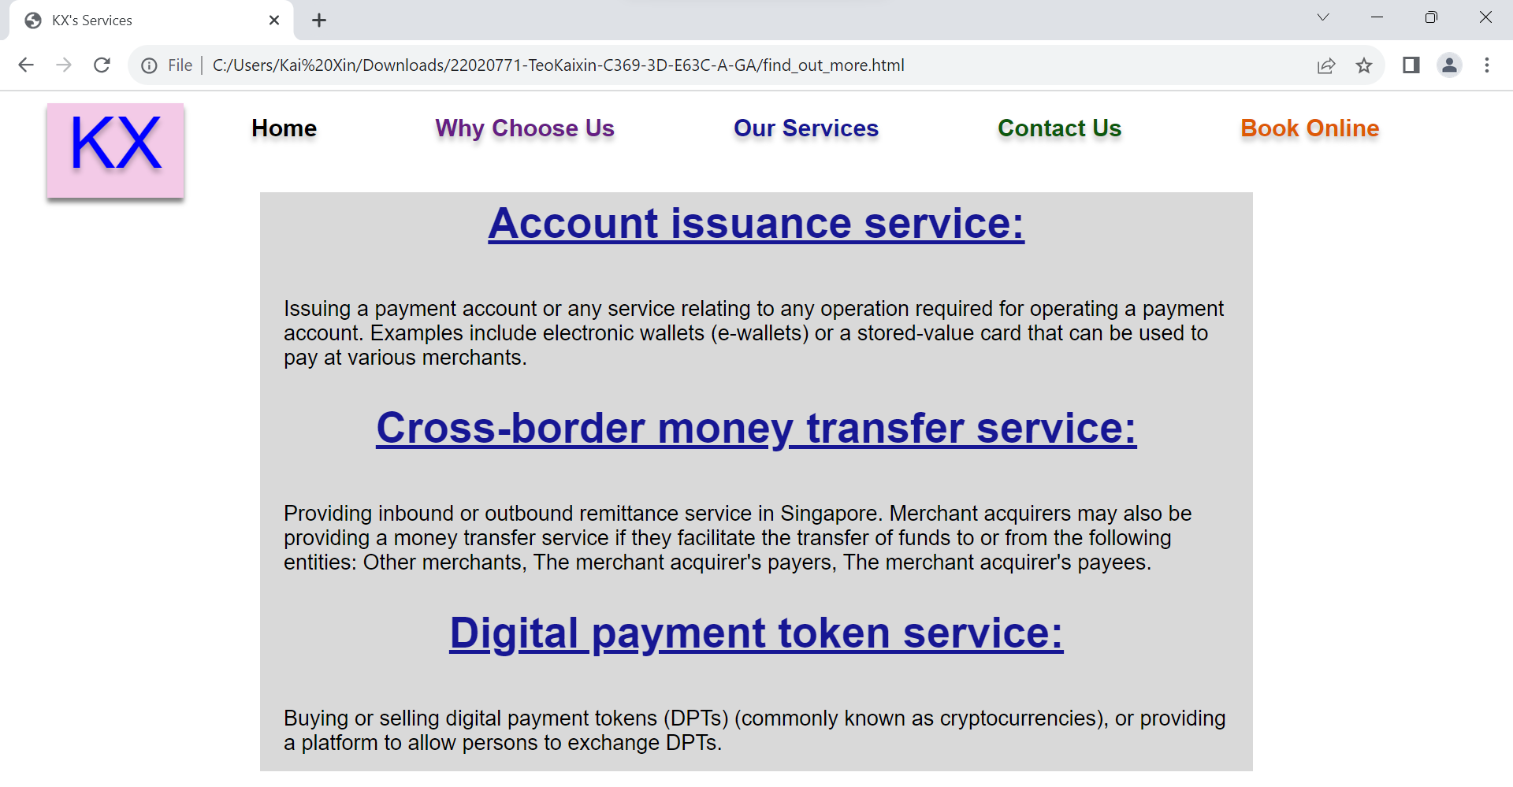
Find out more page

Slide 7
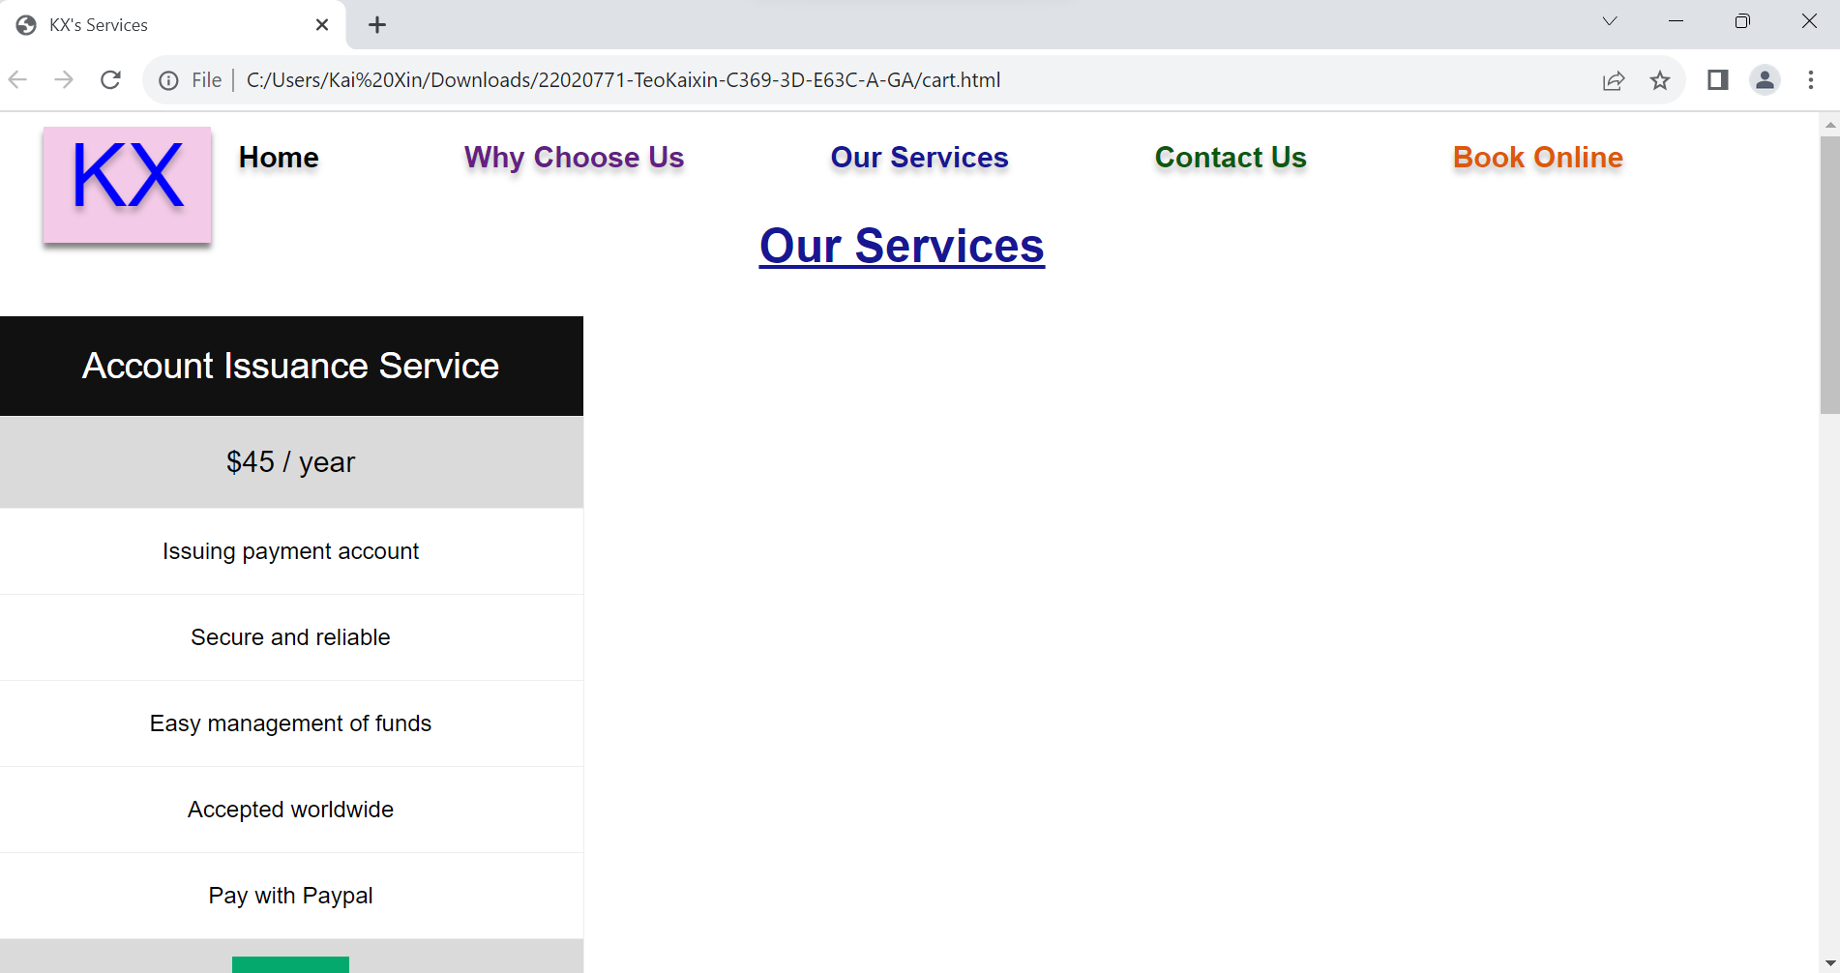
cart page

Slide 8
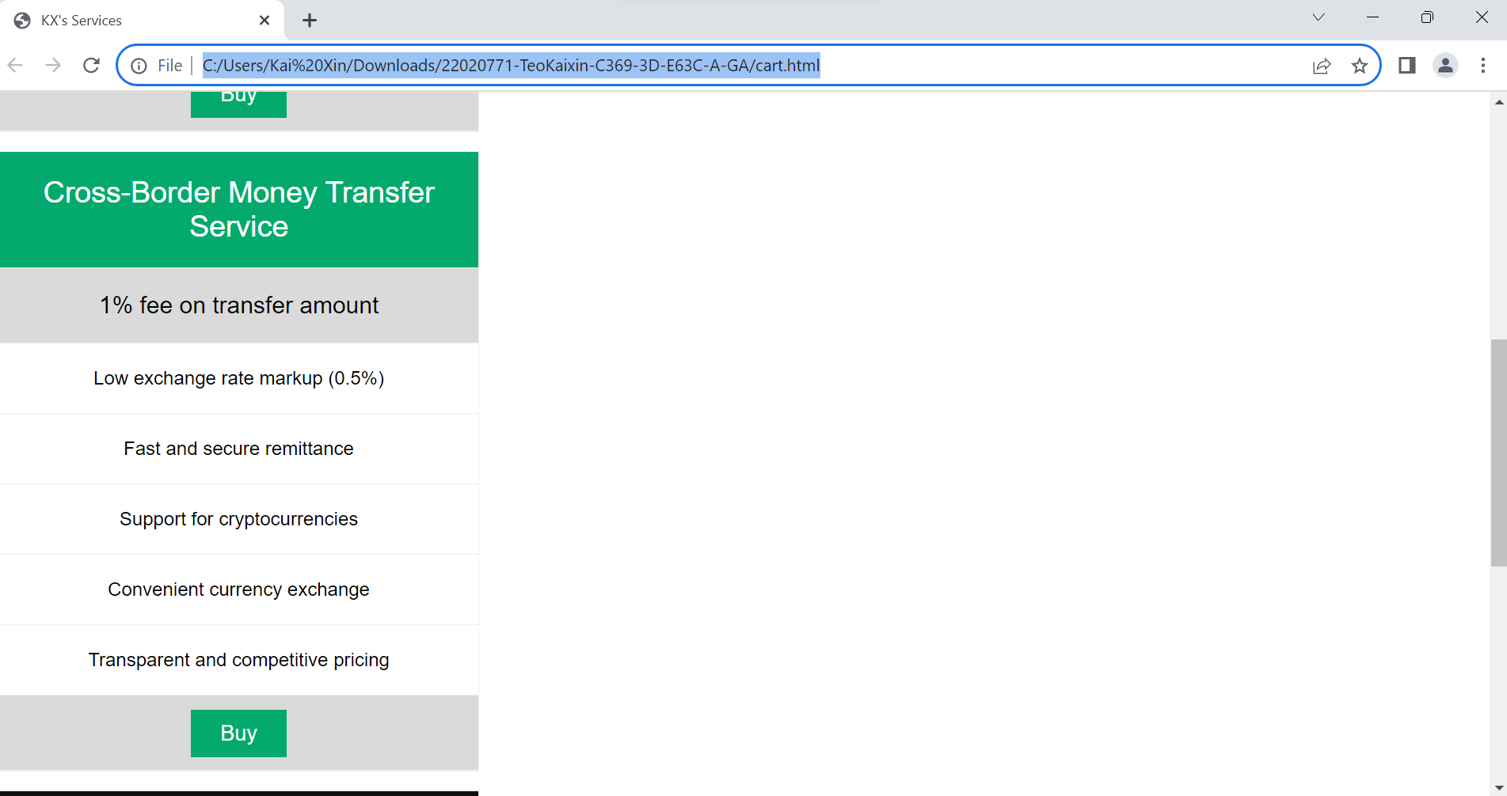
cart page

Slide 9
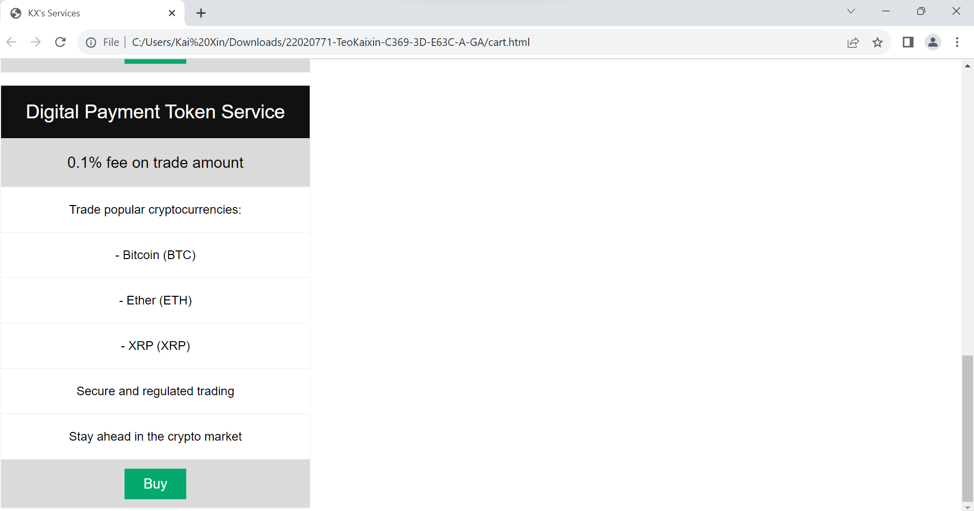
cart page

Slide 10
Transaction page

Slide 11
Transaction page

Slide 12
Transaction page

Slide 13
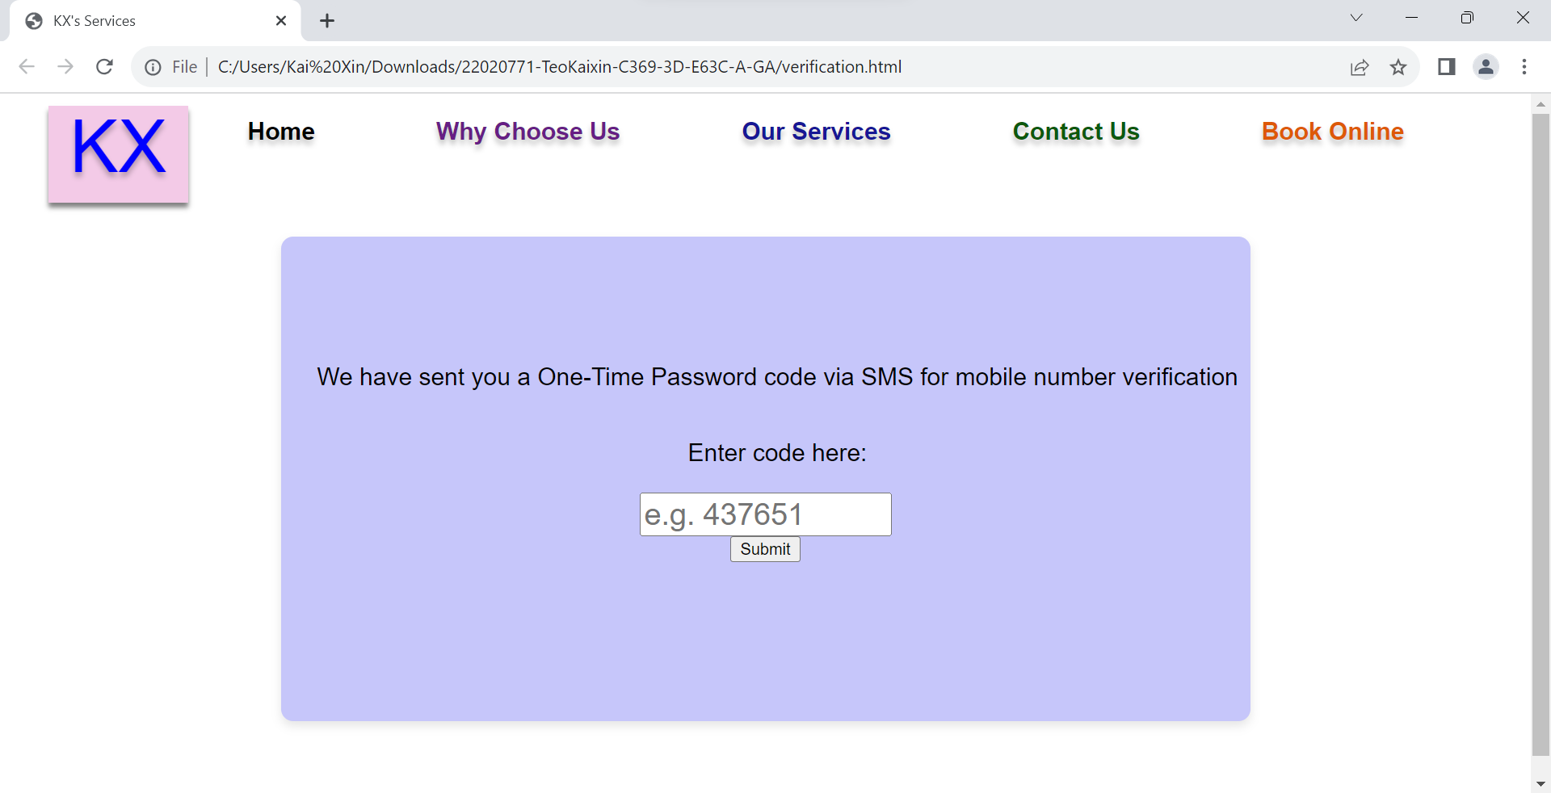
Transaction page

Slide 14
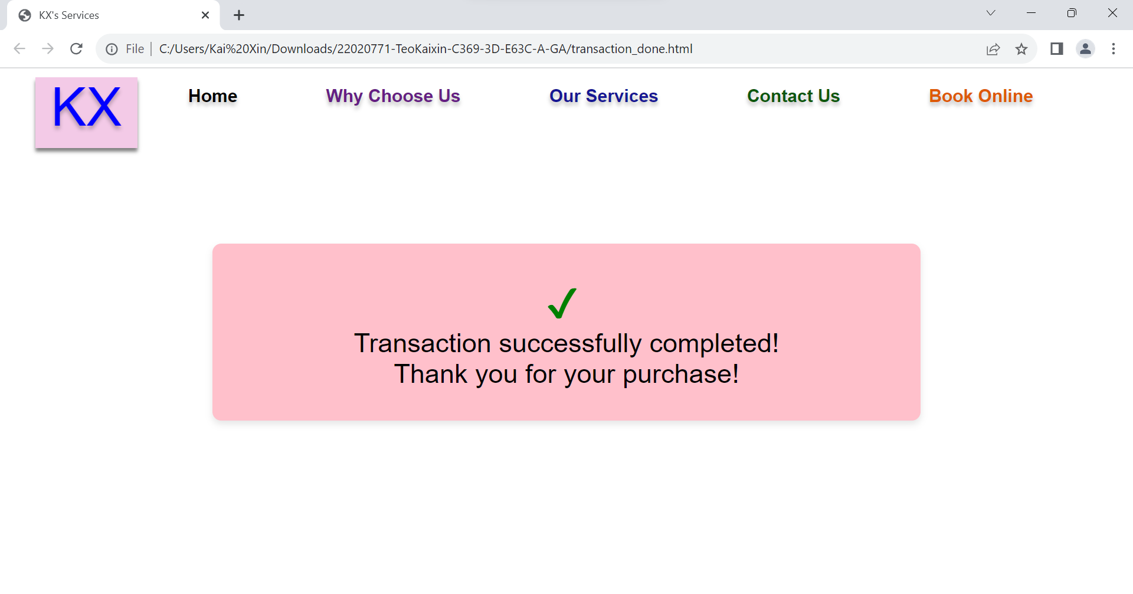
Transaction done page

Slide 15
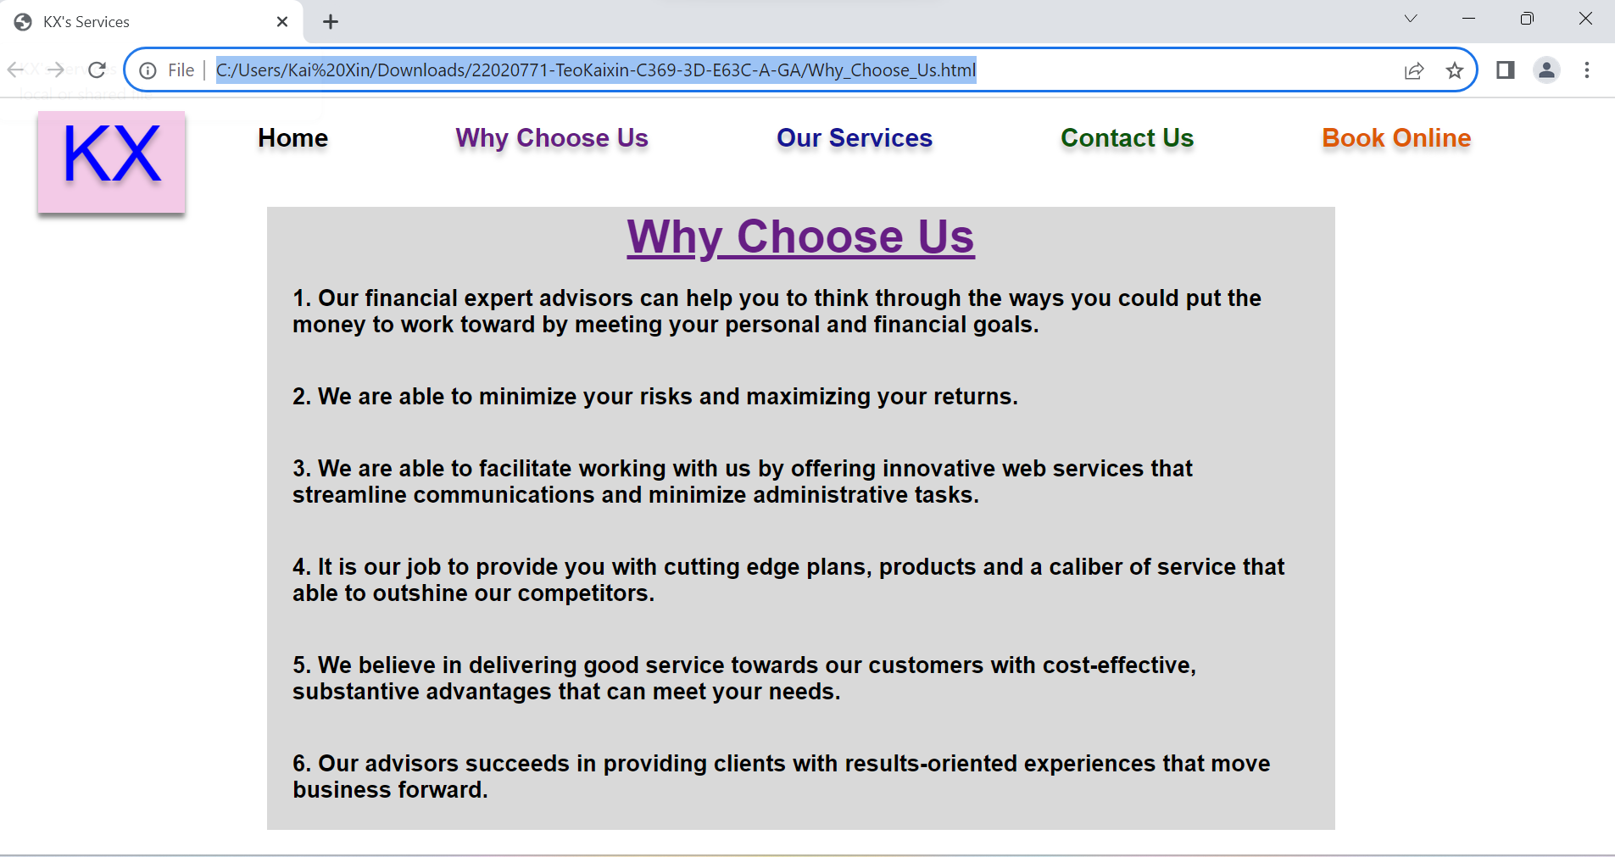
Why choose us page

Slide 16
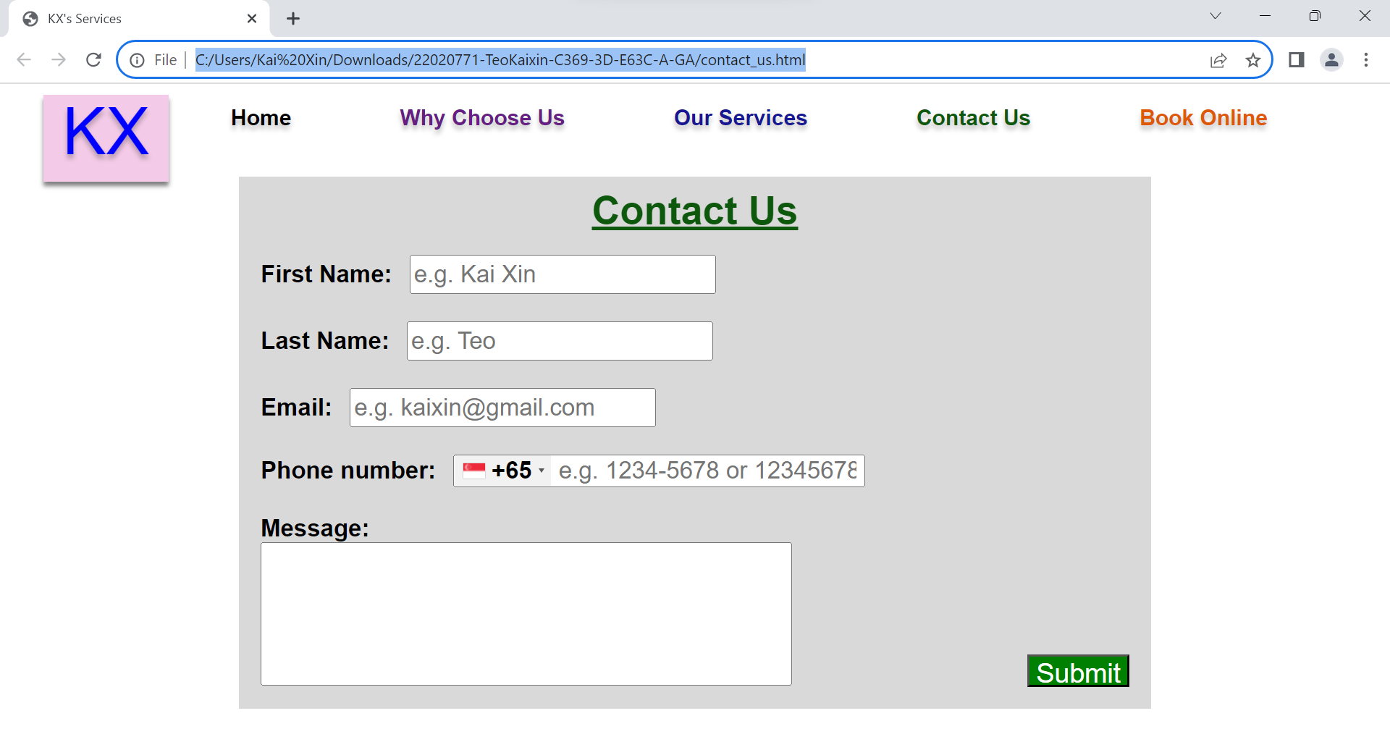
Contact Us page

